Slide 1
Measuring and Reporting Performance
(Module 3 of Syllabus)
The administrator of a large data processing
  center may be interested in increasing throughput—the total amount of work done in a given time.
we often want to relate the performance of two different computers, say, X and Y. The phrase "X is faster than Y" is used
  to mean that the response time or execution time is lower on X than on Y for the given task.
  "X is n times faster than Y" will mean
  n= Execution Timey/ Execution Timex

Slide 2
Why know about performance
Purchasing Perspective:
  Given a collection of machines, which has the
    Best Performance?
    Lowest Price?
    Best Performance/Price?
Design Perspective:
  Faced with design options, which has the
    Best Performance Improvement?
    Lowest Cost?
    Best Performance/Cost ?
Both require
  Basis for comparison
  Metric for evaluation

Slide 3

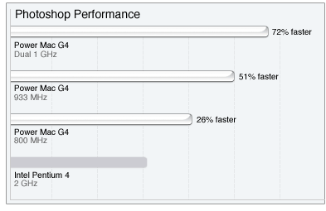
Many possible definitions of performance
Every computer vendor will select one that makes them look good. How do you make sense of conflicting claims?
Q: Why do end users need a new performance metric?
A: End users who rely only on megahertz as an indicator for performance do not have a complete picture of PC processor performance and may pay the price of missed expectations.

Slide 4
Measuring Performance
Latency (response time, execution time)
  Minimize time to wait for a computation
Energy/Power consumption
Throughput (tasks completed per unit time, bandwidth)
  Maximize work done in a given interval
  = 1/latency when there is no overlap among tasks
  > 1/latency when there is
    In real processors there is always overlap (pipelining)
All are important :
  Architecture – Latency is important,
  Embedded system – Power consumption is important,
  Network – Throughput is important
Notes:
Response time, elapsed time, wall-clock time.

Slide 6
Some Definitions
Performance is in units of things/unit time
  E.g., Hamburgers/hour
  Bigger is better
If we are primarily concerned with response time
  Performance(x) = 1 execution_time(x)
Relative performance: “X is N times faster than Y”
N = Performance(X) = execution_time(Y)
Performance(Y) execution_time(X)

Slide 7

From previous slide
Since execution time is the reciprocal of performance, the following relationship
holds:

Slide 8
Relative Performance
“X is n times faster than Y’’ means:
Execution time_{Y}
Execution time_{X}
= n
“X is m% faster than Y’’ means:
Execution time_{Y}
Execution time_{X}
X 100%
= m

Slide 9
Two notions of performance
Which has higher performance?
  Depends on the metric
    Time to do the task (Execution Time, Latency, Response Time)
    Tasks per unit time (Throughput, Bandwidth)
  Response time and throughput are often in opposition
Plane | DC to Paris | Speed | Passengers | Throughput (pmph)
747 | 6.5 hours | 610 mph | 470 | 286,700
Concorde | 3 hours | 1350 mph | 132 | 178,200

Slide 10
Throughput
"the throughput of X is 1.3 times higher than Y" signifies here
  that the number of tasks completed per unit time on computer X is 1.3 times the
  number completed on Y

Slide 11
Execution Time
execution time can be defined in different ways depending on what we count.
  The most straightforward definition of time is called wall-clock time.
response time, or elapsed time, which is the latency to complete a task, including
  disk accesses, memory accesses, input/output activities, operating system overhead—everything

Slide 12
Measuring, Reporting, and Summarizing Performance
With multiprogramming, the processor works on another program
while waiting for I/O and may not necessarily minimize the elapsed time of one program.
need a term to consider this activity. CPU time recognizes this distinction
  the time the processor is computing, not including the time waiting for I/O or running other programs. (Clearly, the response time seen by the user is the elapsed time of the program, not the CPU time.)

Slide 14

Three Components of CPU Performance
CPU time_{X,P} = Instructions executed_{P} * CPI_{X,P} * Clock cycle time_{X}
Cycles Per Instruction

Slide 15
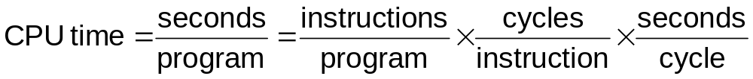
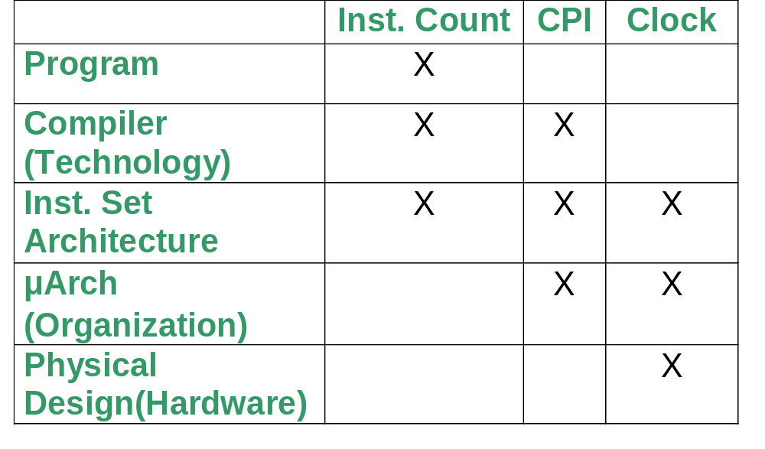
CPU Performance
The Fundamental Law
Three components of CPU performance:
  Instruction count
  CPI
  Clock cycle time

Slide 17
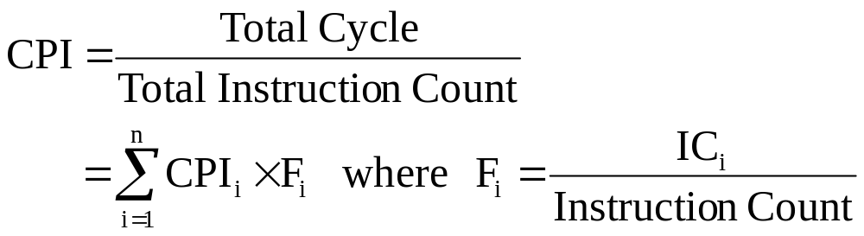
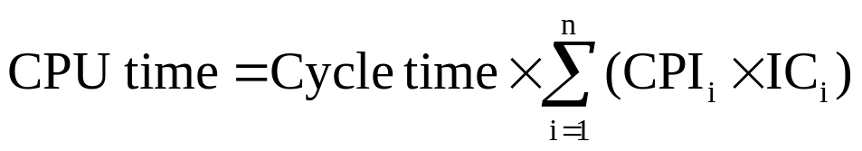
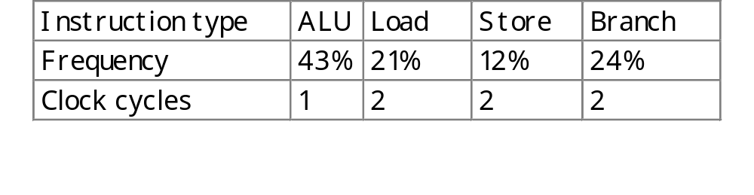
CPI - Cycles per Instruction
  Let Fi be the frequency of type I instructions in a program. Then, Average CPI:
  Example:
average CPI = 0.43 + 0.42 + 0.24 + 0.48 = 1.57 cycles/instruction

Slide 18
CPI
The average number of clock cycles per instruction, or CPI, is a function of the machine and program.
  The CPI depends on the actual instructions appearing in the program—a floating-point intensive application might have a higher CPI than an integer-based program.
  It also depends on the CPU implementation. For example, a Pentium can execute the same instructions as an older 80486, but faster.
It is common to each instruction took one cycle, making CPI = 1.
  The CPI can be >1 due to memory stalls and slow instructions.
  The CPI can be <1 on machines that execute more than 1 instruction per cycle (superscalar).

Slide 19
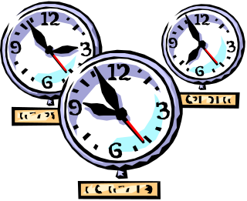
Clock cycle time
One “cycle” is the minimum time it takes the CPU to do any work.
  The clock cycle time or clock period is just the length of a cycle.
  The clock rate, or frequency, is the reciprocal of the cycle time.
Generally, a higher frequency is better.
Some examples illustrate some typical frequencies.
  A 500MHz processor has a cycle time of 2ns.
  A 2GHz (2000MHz) CPU has a cycle time of just 0.5ns (500ps).

Slide 20
Execution time, again
CPU time_{X,P} = Instructions executed_{P} * CPI_{X,P} * Clock cycle time_{X}
The easiest way to remember this is match up the units:
Make things faster by making any component smaller!!
Often easy to reduce one component by increasing another
Seconds | = | Instructions | * | Clock cycles | * | Seconds
Program |  | Program |  | Instructions |  | Clock cycle
 | Program | Compiler | ISA | Organization | Technology
Instruction Executed
CPI
Clock Cycle TIme

Slide 22
Speedup Performance Laws
1) Amdahl’s Law
(Module 3 of Syllabus)
Quantitative Principles of Computer Design
  Make common case fast
    Improving frequent event rather than rare event improves overall performance
      i.e in adding 2 numbers in CPU,
      performance improved by optimizing common case of no overflow rather than rare case of flowchart
To find how much performance can be improved by making, a frequent event faster – Amdahl’s law is used to quantify the values of enhancement (/ non-enhancement)

Slide 23
Amdahl’s Law
A quick way to find speedup from an enhancement, which depends on:
  Fraction of the computation time in the original machine that can be converted to take advantage of the enhancement
    Example : If 20 seconds of execution time of a program that takes 60 seconds in total can use an enhancement, the fraction is Fractionenhanced = 20/60 is always less than 1
  How much faster the task would run if the enhanced mode were used for the entire program
    If the enhanced mode takes 10 seconds for some portion of program that can completely use enhanced mode and the original mode took 20 seconds for the same portion, the improvement is Speedupenhanced = 20/10 always greater than 1

Slide 24
Compute Speedup – Amdahl’s Law
Speedup is due to enhancement(E):
Time_{Before}
Time_{After}
Execution time without E (Before)
Execution time with E (After)
Speedup (E) =
Suppose that enhancement E accelerates a fraction F (Fractionenhanced )
of the task by a factor S(Speedupenhanced ), and the remainder of the task
is unaffected, what is the Execution time_{after} and Speedup(E) ?

Slide 25
Amdahl’s Law
= ExTime_{before} x [(1- F) +
F
S
]
Execution time_{after}
ExTime_{before}
ExTime_{after}
1
Speedup(E)
=
=
[(1-F) +
F
S
]
(F= fraction of total time that is speeded up ie 20 seconds out of total of 60 seconds
= 20/60
20 secs is speeded up to 10 seconds,say)
S= 20/10

Slide 26
Amdahl’s Law :Example Given in Previous slide
Extime_{before = 60 ,} Fractionenhanced (F) = 20/60, Speedupenhanced (S)= 20/10
= ExTime_{before} x [(1- F) +
F
S
]
Execution time_{after}
= 60 x 5/6=50
Execution time_{after}
= 60 - 60 x 20/60 + 60 x 20/60x 10/20
= 60-20 + 10 = 40 + 10 =50
ExecutionTimeNon Enhanced Portion + Execution time of Enhanced portion
[(1-F) +
F
S
]
= (1-20/60) + 20/60 x 10/20 = 2/3+1/6=5/6
(1-F) >>much greater than F/S i.e 2/3 >> 1/6
ExTime_{before}
ExTime_{after}
6
Speedup(E)
=
=
5
= 1.2
Check 60/50= 1.2
Corollary : We can’t Speedup the task more than the reciprocal of 1 minus the fraction , that is the portion that is not speeded up , here (1/(1-20/60)=3/2=1.5) Ref:pp 31 Patterson

Slide 27
Amdahl’s Law – An Example
Q: Floating point instructions improved to run 2X;
but only 10% of execution time are FP ops. What is the execution time and speedup after improvement?
Ans:
F = 0.1, S = 2
ExTime_{after} = ExTime_{before} x [ (1-0.1) + 0.1/2 ] = 0.95 ExTime_{before}
ExTime_{before}
1
0.95
Speedup =
=
= 1.053
ExTime_{after}

Slide 28
Amdahl’s Law for Multiple Processors
based on fixed workload or fixed problem size
computational workload W is fixed while the number of processors that can work on W can be increased.
Denote the execution rate of i processors as R i then in a relative comparison they can be simplified as and R1=1… Rn=n.
The workload is also simplified. We assume that the workload consists of sequential work Wα and n parallel work 1-αW ,
where α is between 0 and 1. More specifically, this workload can be written in a vector form as, (α,0,...,0, 1- α)W, or W1=α W, Wn= (1-α) W , Wi=0 for all i ≠ 1,n .

Slide 29


Amdahl’s Law for Multiple Processors
The execution time of the given work by n processors is then computed as,
Speedup of n processor system is defined using a
ratio of execution time, i.e.,

Slide 30



Amdahl’s Law for Multiple Processors
Substituting the execution time in relation to W gives
:
Equation called Amdahl’s Law
If the number of processors is increased infinity, the speedup becomes
This is sequential bottle neck of multiprocessor system
The speedup can NOT be increased to infinity even if the number of processors is increased to infinity.

Slide 31
Gustafson’s Law
For scaled up problems( problem scaled to match the computing power of the machine as number of processors is increased)
workload is scaled up to maintain a fixed execution time as the number of processors increases,
workload is scaled up on an n-node machine as

Slide 32



Gustafson’s Law
Speedup for the scaled up workload is then,
Simplifying above equation produces the Gustafson’s law:
the speedup increases linearly.
What Gustafson’s law says
  true parallel power of a large multiprocessor system is only achievable when a large parallel problem is applied.

Slide 33
Example of Amdahl’s Law
Suppose that a calculation has a 4% serial portion, what is the limit of speedup on 16 processors?
  16/(1 + (16 – 1)*.04) = 10
  What is the maximum speedup?
    1/0.04 = 25

Slide 34
Example questions
Given a (scaled) speed up of 20 on 32 processors, what is the serial fraction from Amdahl’s law?, From Gustafson’s Law?
A program attains 89% efficiency with a serial fraction of 2%. Approximately how many processors are being used according to Amdahl’s law?

Slide 35

Efficiency
  S-speedup
  N -number of processors
The pitfall of these rather optimistic speedup and efficiency evaluations is related to the fact that, as the problem size increases, communication costs will increase, but increase in communication costs are not accounted for by Gustafson’s law.

Slide 36
Excercises
A program has 10% task that cannot be executed parallel in a given machine . You get 100such machines . What would be the speed up with a 100 machines with respect to a single machine for executing the given program using Amdahl’s law? What would be the corresponding result if you use Gustafson’s law?
State assumptions in Amdahl’s Law an Gustafson’s Law

Slide 37
MIPS and MFLOPS
MIPS: millions of instructions per second:
  MIPS = Inst. count/ (CPU time * 10**6) = Clock rate/(CPI*10⁶)
  easy to understand and to market
  inst. set dependent, cannot be used across machines.
  program dependent
  can vary inversely to performance! (why? read the book)
MFLOPS: million of FP ops per second.
  less compiler dependent than MIPS.
  not all FP ops are implemented in h/w on all machines.
  not all FP ops have same latencies.
  normalized MFLOPS: uses an equivalence table to even out the various latencies of FP ops.

